Slide 1
Lab 5: Electrical Circuit Interfaces to digital logic
By Carson Murray

Slide 2
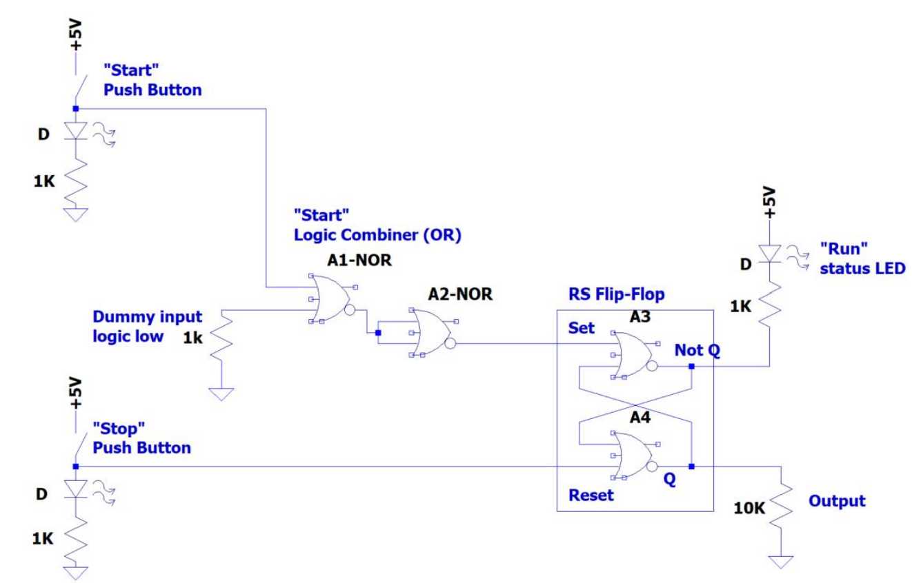
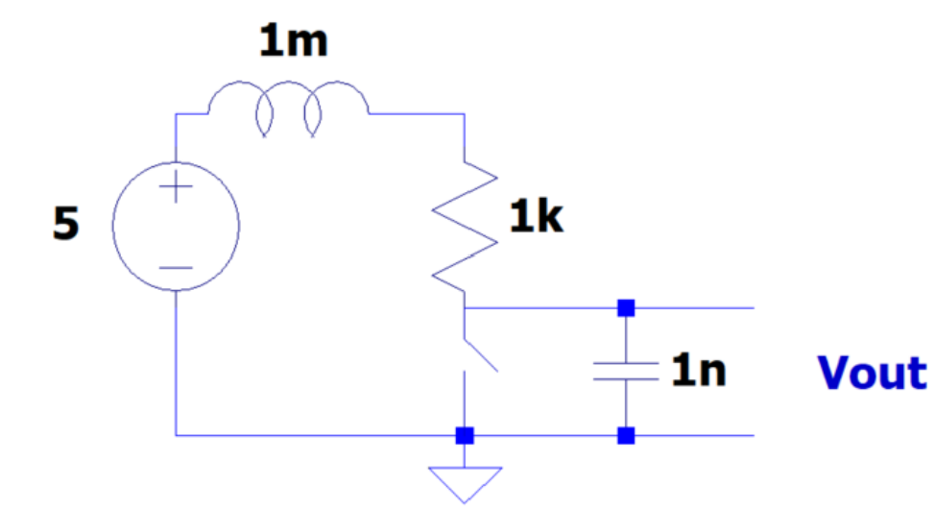
Circuit Diagrams
Circuit 1: RLC transient Response Circuit
Circuit 2: Digital Logic Circuit

Slide 3
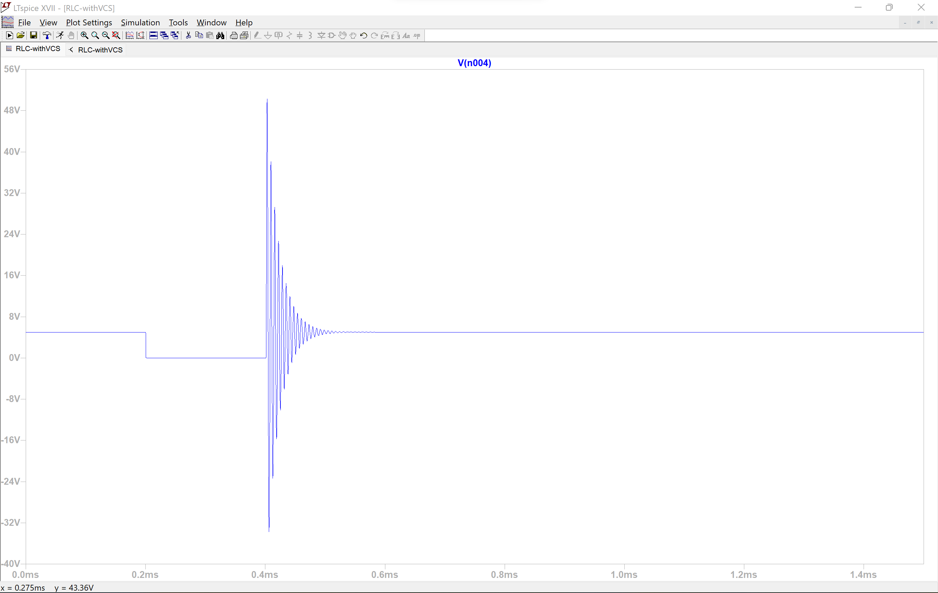
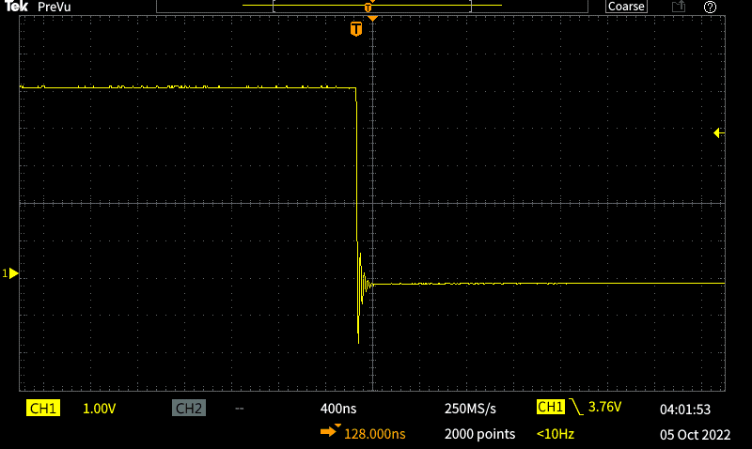
RLC Waveforms: Simulated Vs. Experimental 100 Ohm Resistor
Simulation
Experimental

Slide 4
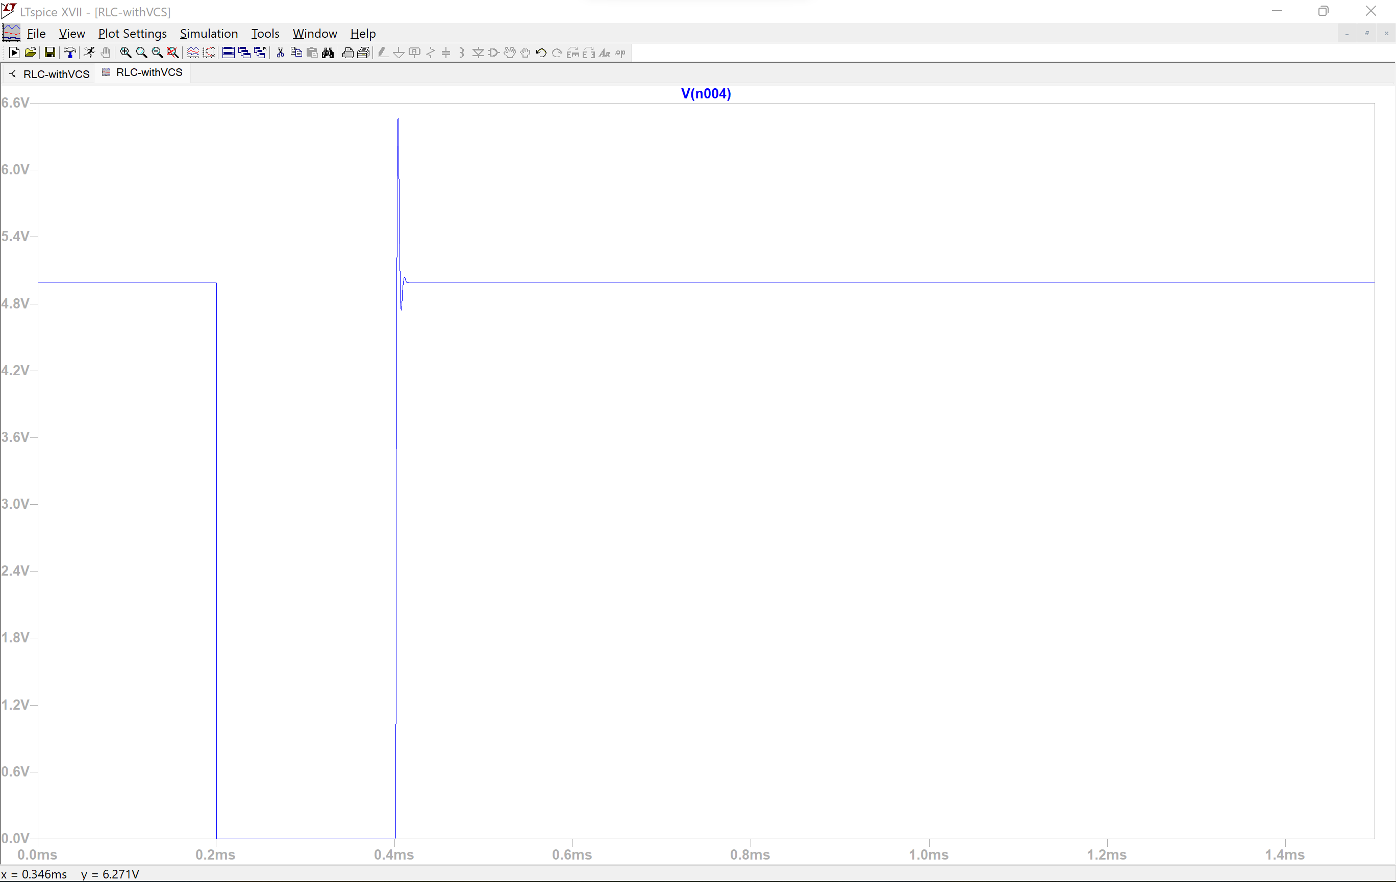
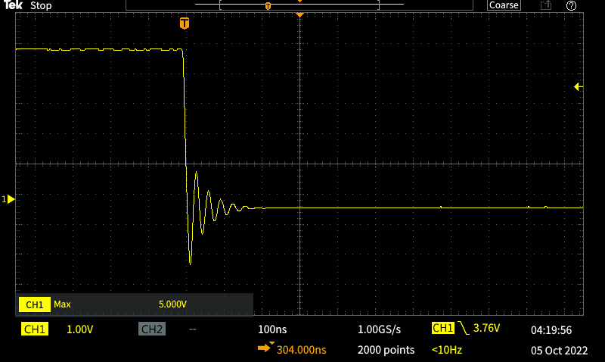
RLC Waveforms: Simulated Vs. Experimental 1 kilo-Ohm Resistor
Simulation
Experimental

Slide 5
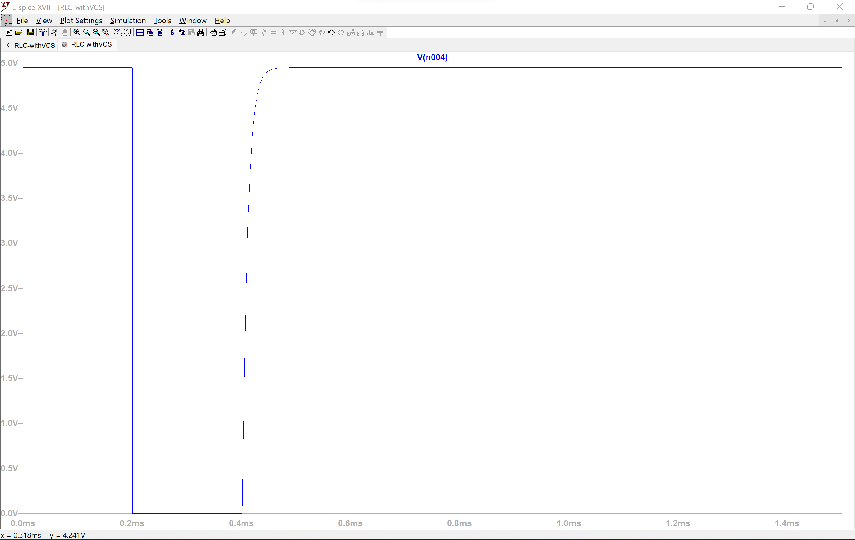
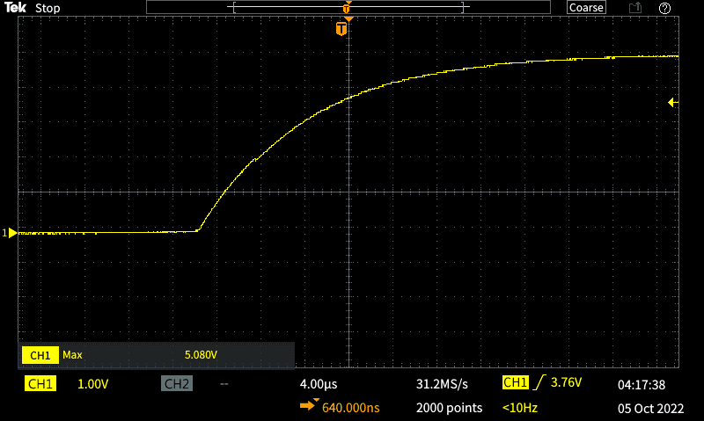
RLC Waveforms: Simulated Vs. Experimental 10 kilo-Ohm Resistor
Simulation
Experimental

Slide 6
Circuit 1 Observations
The simulated waveforms appear to be closely related to their experimental counterpart.
The oscillation of the voltage waveform is caused by the switch “contact “bouncing”.

Slide 7
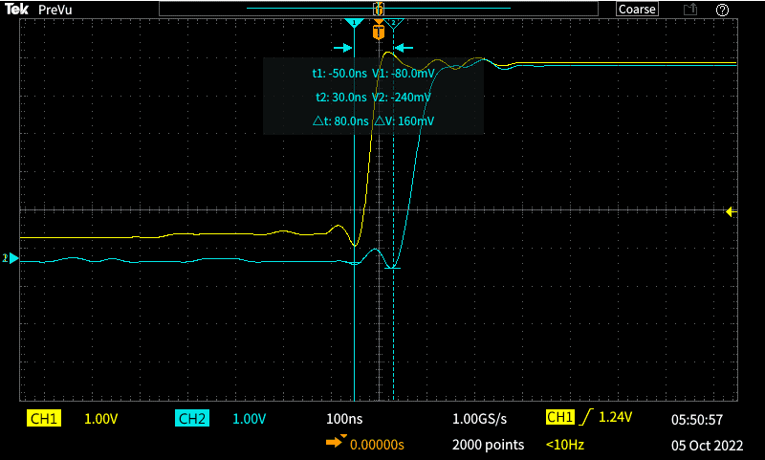
Circuit 2: Propagation Delay of the logic combiner
The time difference is around 80 ns.
Channel 1 is the input side of the first NOR gate
Channel 2 is the output side of the second NOR gate

Slide 8
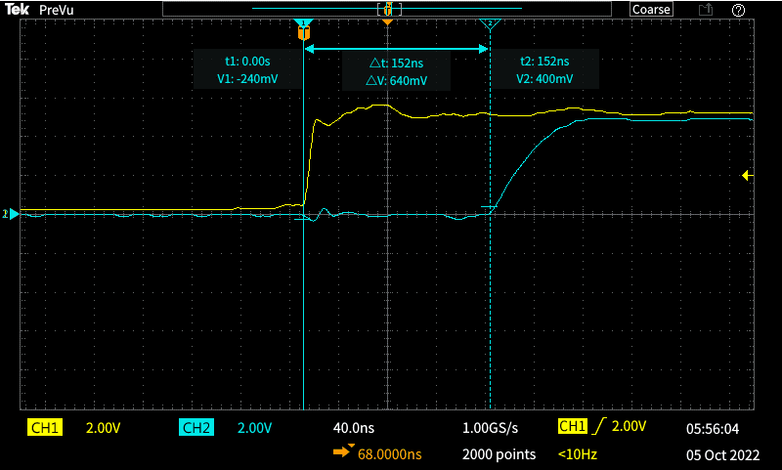
Circuit 2: Propagation Delay of the RS Flip Flop and Logic Combiner
The time delay is around 152 ns
Channel 1 is the input of the first NOR gate
Channel 2 is the output of the RS Flip Flop
Notice the increase in delay due to the more gates added, compared to the previous waveform.

Slide 9
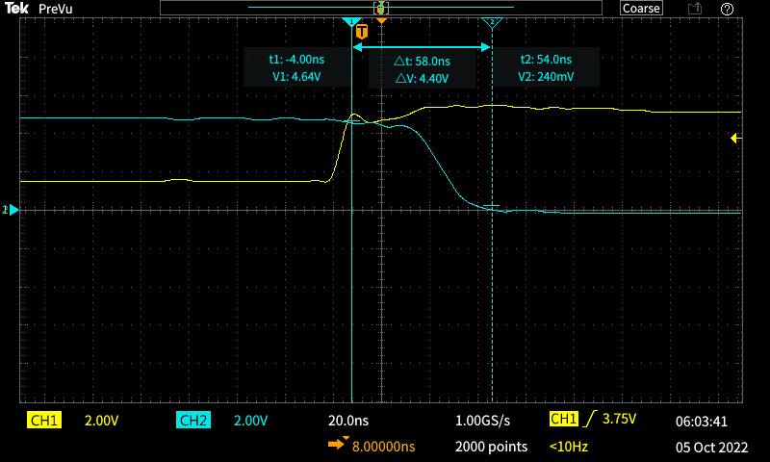
Circuit 2: Propagation delay of reset output
The time delay is around 58 ns
Channel 1 is the reset input on the RS Flip Flop
Channel 2 is the RS Flip Flop output

Slide 10
Time delay measurement results
Measurement | Experimental Time Delay (ns)
1. Voltage at the input side of the first gate to the output of the second gate | 80
2. “Start” switch signal crosses the logic “high” threshold, to the output of the flipflop changes to the Set condition | 152
3. “Stop” switch signal crosses the logic high threshold, to the output of the flipflop changes to logic low. | 58
Expectedly, more gates create more of a time delay
Comparing measurement 1 to measurement 2:
Measurement 1 must go through 2 gates
Measurement 2 must go through 4 gates
Thus Measurement 1 takes less time
Comparing measurement 1 to measurement 3:
Measurement 1 must go through 2 gates (logic combiner)
Measurement 3 must go through 2 gates (flip flop)
Both go through two gates, but the gates are arranged differently

